Slide 1
Personal Software Process
for Engineers: Part I
Process Measurement
SM

Slide 2
Lecture Topics
Process measurement
Software size
  why measure size
  size measurement criteria
  the SEI size measurement framework
Counting program size
  size counters
  coding standards

Slide 3
Process Measurement Principles
To be useful, measurements should be
  gathered for a specific purpose
  explicitly defined
  properly managed
  properly used
Measuring your process will not improve it. You must make process changes to achieve lasting improvement.

Slide 4
Process Measurement Purposes
We measure to
  understand and manage change
  predict or plan for the future
  compare one product, process, or organization with another
  determine adherence to standards
  provide a basis for control

Slide 5
Measurement Objectives
Measurements only produce numbers.
To be useful, they must
  relate to business objectives
  be properly interpreted
  lead to appropriate action
If the business purposes for the measurements are not understood
  the wrong data may be gathered
  data may not be properly used

Slide 6
Types of Measurements
We generally need objective and explicit measures.
To be useful, we need relationships that correlate.
  program size versus development hours
  cost distributions
  defect densities
We also seek a controlling or predictive capability.
  actions to reduce test defects
  steps to improve review quality
  means to improve productivity

Slide 7
The PSP Measurements
The basic PSP data are
  program size
  time spent by phase
  defects found and injected by phase
Both actual and estimated data are gathered on every item.
Measures derived from these data
  support planning
  characterize process quality

Slide 8
PSP Size Measures
The goals of the PSP size measures are to
  define a consistent size measure
  establish a basis for normalizing time and defect data
  help make better size estimates
Some of the questions these data can help to answer are
  What size program did I plan to develop?
  How good was my size estimate?
  What was the completed size of the finished program?

Slide 9
PSP Time Measures
The goals of the PSP time measures are to
  determine how much time you spend in each PSP phase
  help you to make better time estimates
Typical questions these data can help answer are
  How much time did I spend by PSP phase?
  How much time did I plan to spend by PSP phase?

Slide 10
PSP Defect Measures
The goals of the PSP defect measures are to
  provide a historical baseline of defect data
  understand the numbers and types of defects injected
  understand the relative costs of removing defects in each PSP phase
Some questions these data can help answer are
  How many defects did I make in each phase?
  How many defects did I remove in each phase?
  How much time did it take to find and fix each defect?

Slide 11
PSP Derived Measures
Some PSP derived measures are
  To Date and To Date %
  Product size developed or reviewed per hour
  CPI
  % Reuse and % New Reusable
  A/FR
  PQI
You will learn about these measures in the rest of the PSP course.

Slide 12
Size Measurement Criteria
Size measurements must be
  related to development effort
  precise
  machine countable
  suitable for early planning

Slide 13
Size Versus Development Effort
The principal requirement: If the size measure is not directly related to development cost, it is not worth using.
There are many possible measures.
  database elements
  lines of code (LOC)
  function points
  pages, screens, scripts, reports
The size measure should be sensitive to language, design, and development practice.

Slide 14
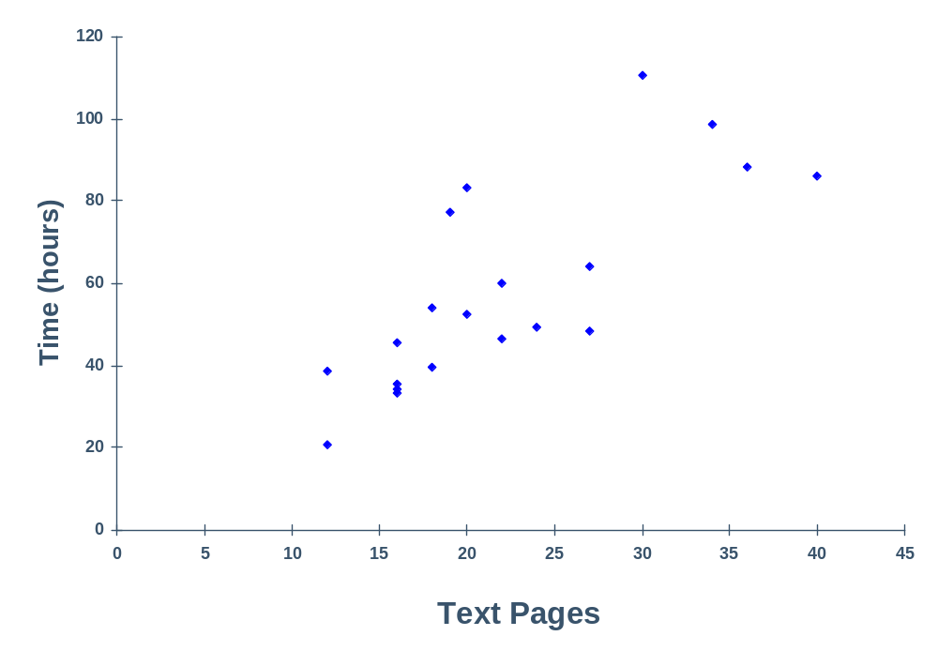
Text Pages Versus Time

Slide 15
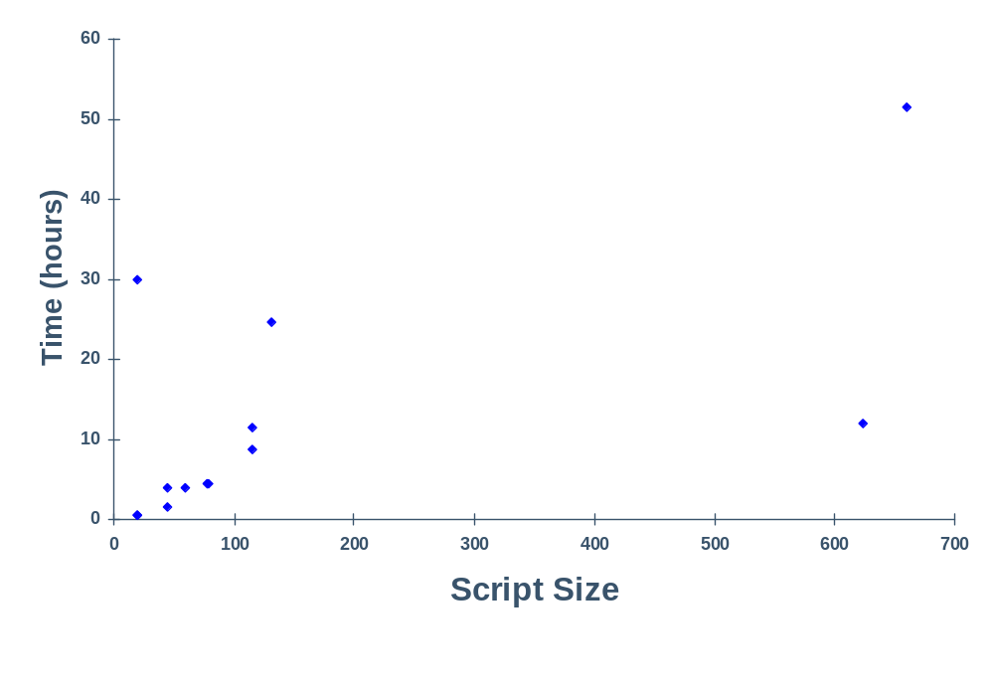
Script Size Versus Time

Slide 16
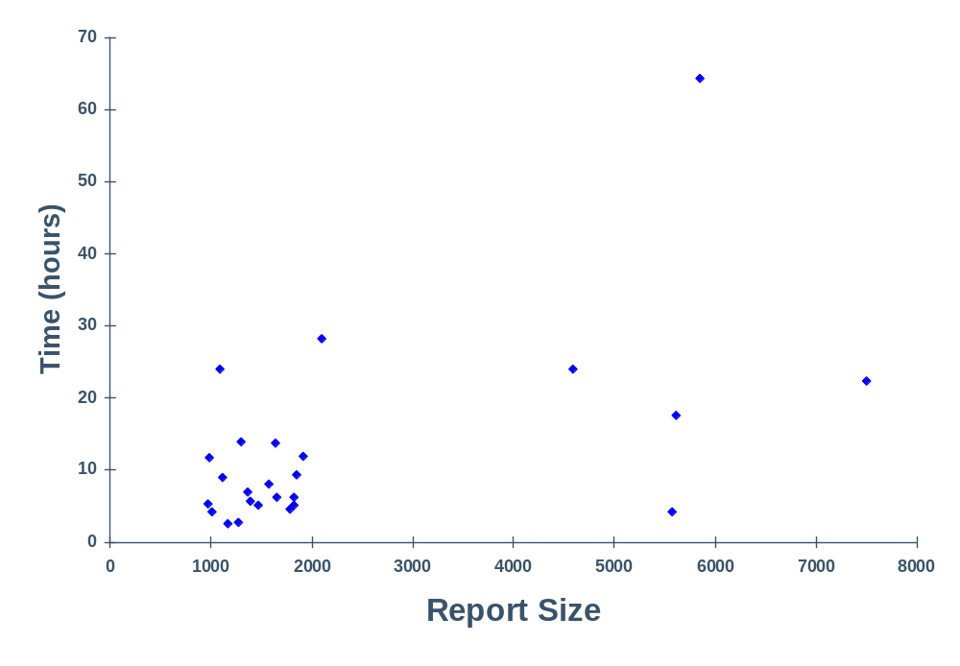
Report Size Versus Time

Slide 17
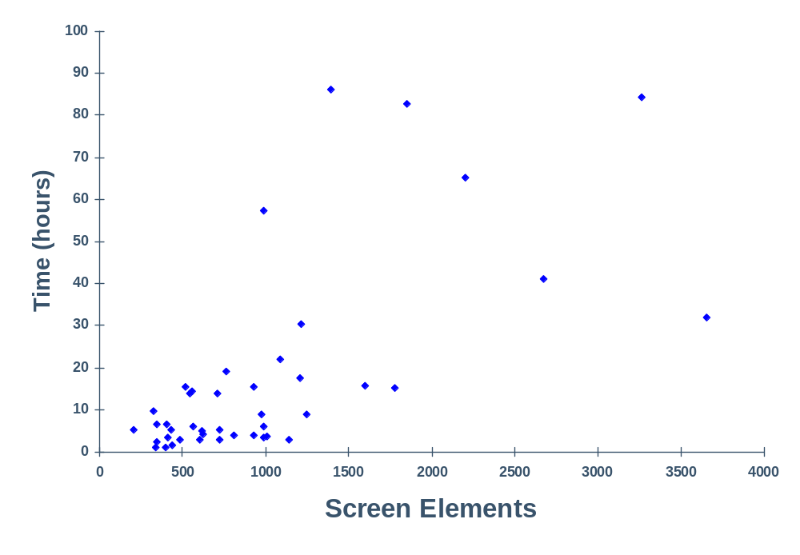
Screen Elements Versus Time

Slide 18
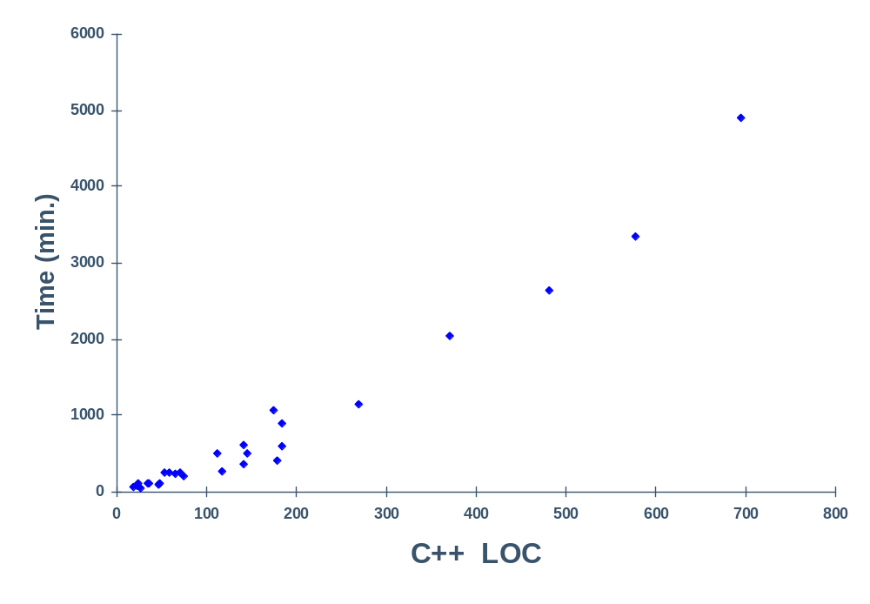
C++ LOC Versus Time

Slide 19
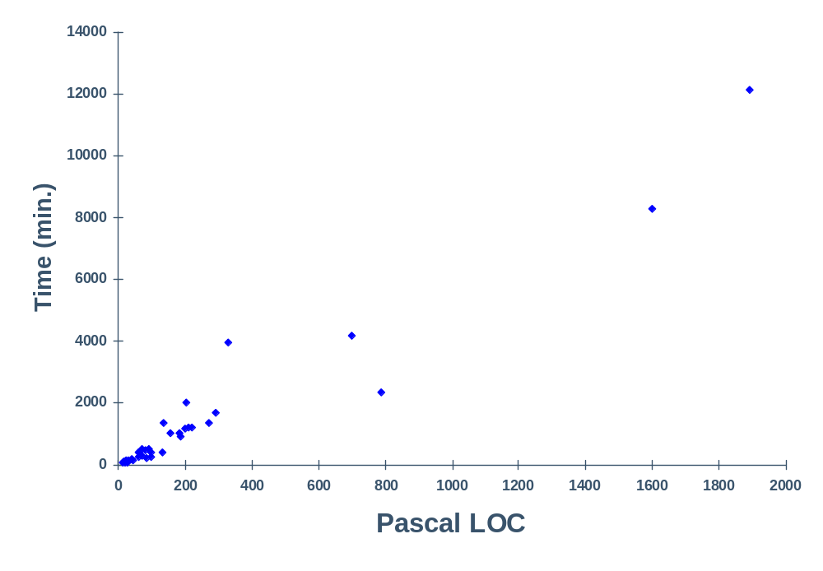
Pascal LOC Versus Time

Slide 20
Relationship to Development
Pages are often an acceptable measure for document development.
LOC is usually a good measure for developing source programs like Pascal and C++.
Other possible measures are function points, screens, modules, database elements, and maintenance fixes.

Slide 21
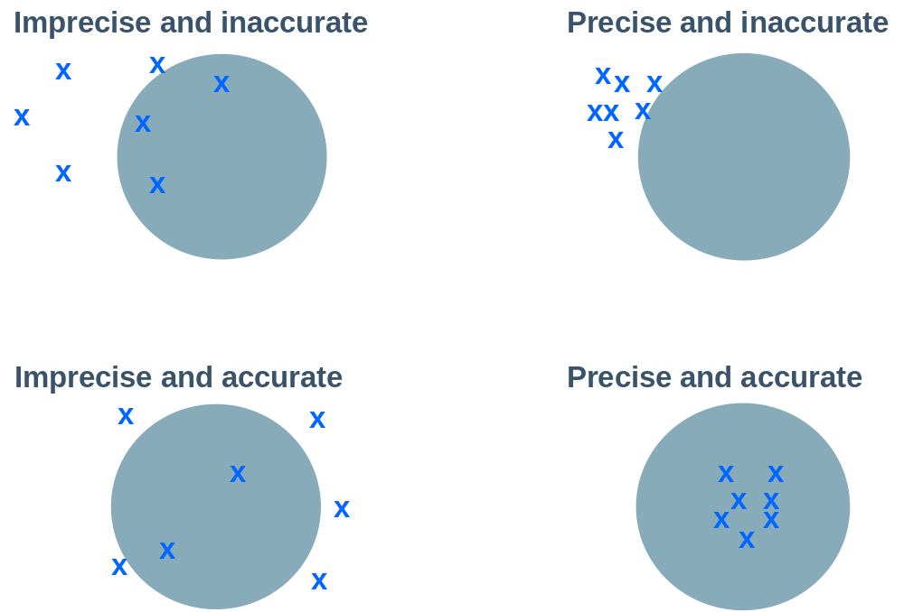
Precision and Accuracy

Slide 22
Measurement Precision
When two people measure the same thing, will they get the same result?
To do so requires a precise measurement definition.
The measure must also be properly applied.
  Different people will likely have different definitions of database elements.
  Pascal LOC do not equate to assembler LOC.
  New LOC are not the same as modified LOC.
  Logical LOC do not equate to physical LOC.
  One person’s C++ LOC may not relate to someone else’s C++ LOC.

Slide 23
Machine Countable
Manual size counting is time-consuming and inaccurate.
Automated counters will only work for defined product characteristics.
Counters can be complex, depending on the
  size definition selected
  counting method used

Slide 24
Suitable for Early Planning -1
For making initial project plans, measures are needed that you can visualize at the beginning of the job.
  For a house, square feet predicts cost.
  Few people can visualize a house in terms of square feet of living space.
  Numbers of rooms is more intuitive.
Intuitive size measures are usually needed for initial plans.

Slide 25
Suitable for Early Planning -2
Unfortunately, popular intuitive measures are not often measurable, and popular measurable measures are often not intuitive.
Function points
  intuitive
  not directly measurable
LOC
  not intuitive
  directly measurable

Slide 26
Selecting a Size Measure -1
Start with product development data.
  resources required
  product characteristic measures
  any special development conditions
Rank products by resources required.
See what characteristics distinguish those products that took the greatest effort from those that took the least.

Slide 27
Selecting a Size Measure -2
See if these differences are measurable.
  Correlate a selected measure for the product set.
  If there is no correlation, try again.
There may be no single best measure.
  A combination of measures could be needed.
  Methods for handling multiple measures are discussed later.

Slide 28
Selecting a Size Measure -3
If you are better at estimating resources than program size, size estimation will not improve your planning.
If you estimate resources directly, you must
  keep accurate records
  build a large database
  use an estimating guru

Slide 29
LOC Measurement
The suggested PSP LOC measure uses logical (versus physical) lines of code.
Statement specifications
  executable
  nonexecutable
  counted statement types
Application
  language and code type
  origin and usage

Slide 30
Counting Program Size -1
Logical lines
  invariant to editing changes
  correlate with development effort
  uniquely definable
  complex to count
Physical lines
  are easy to count
  are not invariant
  must be precisely defined for each case

Slide 31
Counting Program Size -2
The PSP uses a coding standard and a physical counter for LOC size measures.
  defined coding standard
  physical line for each logical line
This standard must be faithfully followed.
Then, physical line counting equals logical line counting.

Slide 32
A LOC Counting Example
procedure ISet.Set(var N: int; var inc: boolean);
begin
inc := false;
SearchPtr := SetStart;
while (SearchPtr<>nil) and (inc == false) do
if SearchPtr^.ThisN == N
then
inc := true
else
SearchPtr:=SearchPtr^.NextN;
end;

Slide 33
PSP’s LOC Counting Standard
Count all statements. This includes
  begin, end, if, then, else,
  {, }, ;, .,
  declarations, directives, headers, etc.
Do not count blanks, comment lines, or automatically generated code.
Count added and modified code for measuring and estimating development productivity.

Slide 34
Size Accounting
For small products, size tracking can be done manually, but it requires care.
For larger products, size tracking requires an accounting system.
Size accounting provides an orderly and precise way of tracking size changes through multiple product versions.

Slide 35
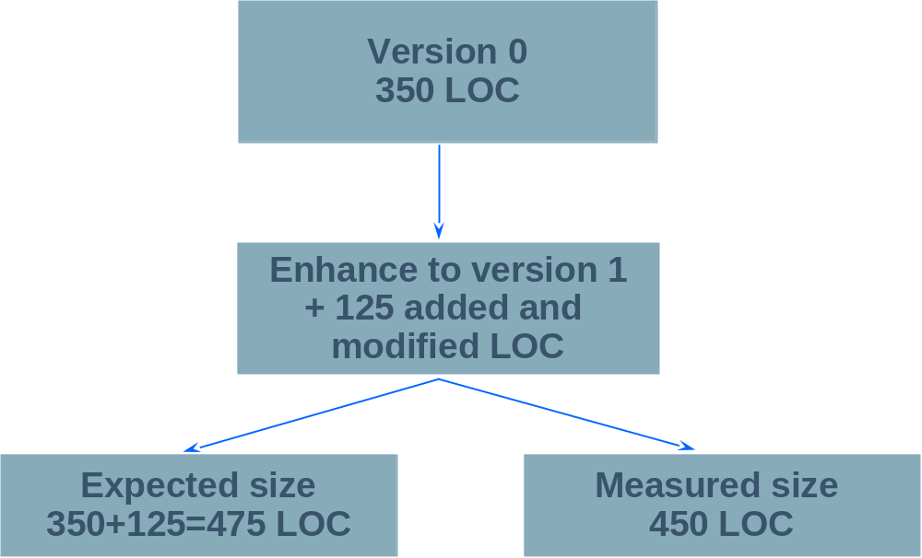
Example of Size Accounting -1
What happened?

Slide 36
Example of Size Accounting -2
 | Added | Subtracted | Base
Base V0 |  |  | 0
Deleted |  | 0
Modified | 0 | 0
Added | 350
Base V1 | 350 | -0 | 350
Deleted |  | 0
Modified | 25 | 25
Added | 100
V1 Product | 125 | -25 | 450
Total Added and Modified LOC |  |  | 475

Slide 37
Messages to Remember
To effectively plan and manage your work, you must measure product size.
For different types of work, use different size measures.
For each measure, size must correlate with development time.
If the size measure does not correlate or is not automatically countable, it will not be very useful.
Every size measure should be precisely defined and automatically countable.

